Slide 1


Data Science: Principles and Practice
Lecture 2: Linear Regression
Ekaterina Kochmar¹
________________________________________
¹ Based on slides from Marek Rei

Slide 2
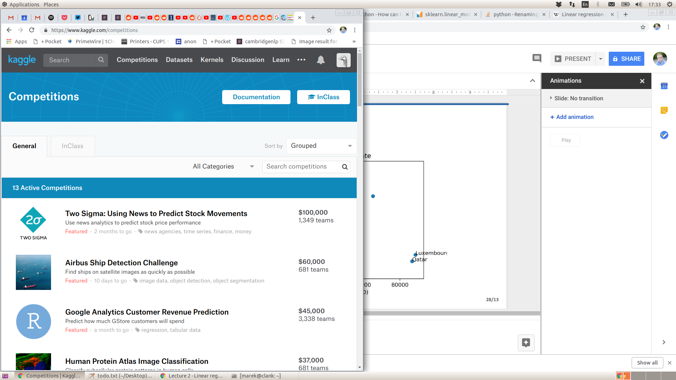
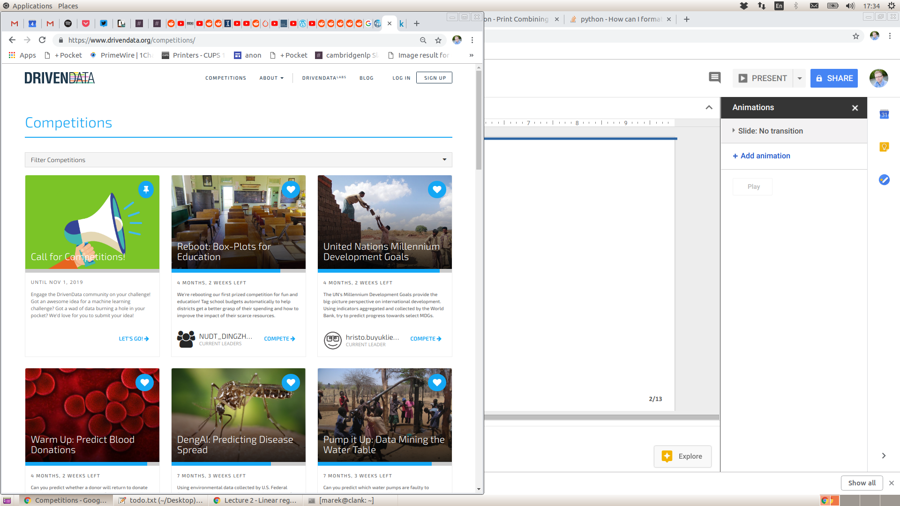
kaggle.com
drivendata.org

Slide 3
Data Science: Principles and Practice
01
Linear Regression
02
Optimization with Gradient Descent
03
Multiple Linear Regression and Polynomial Features
04
Overfitting
05
The First Practical

Slide 4
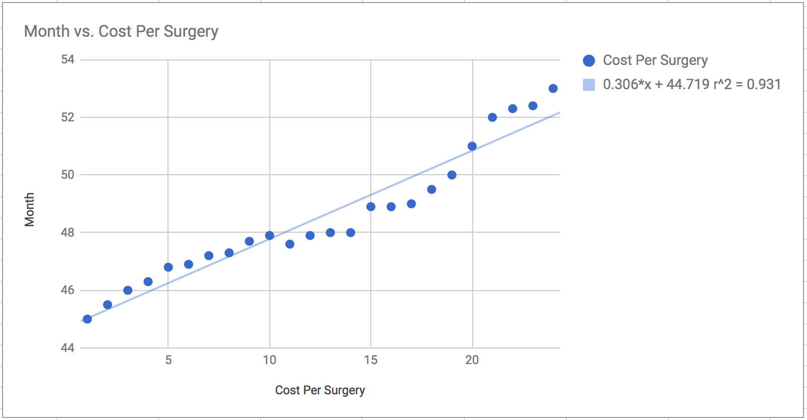
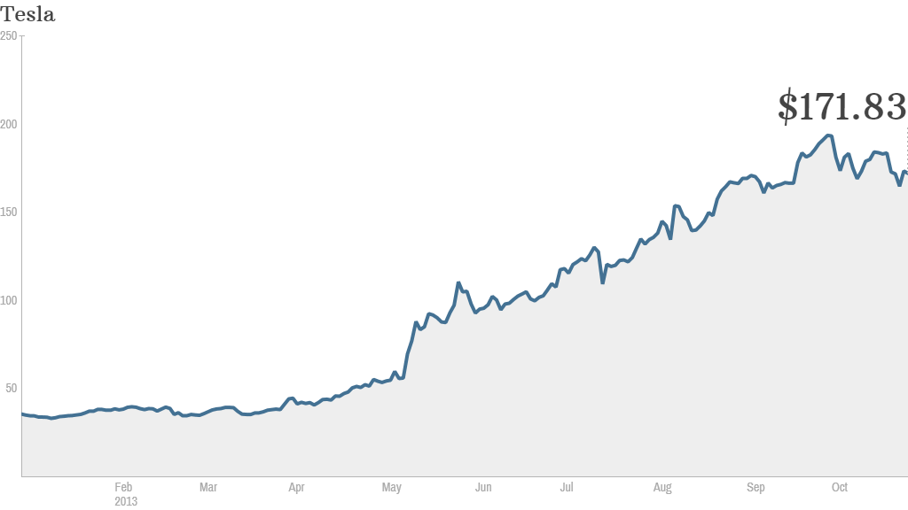
Linear regression
Linear regression helps modelling how changes in one or more input variables (independent variables) affect the output (dependent variable)
Widely used algorithm in machine learning and data science. Application areas: healthcare, social sciences, economics, environmental science, prediction of planetary movements
Linear regression is an example of supervised learning algorithms
https://towardsdatascience.com/examples-of-applied-data-science-in-healthcare-and-e-commerce-e3b4a77ed306

Slide 5
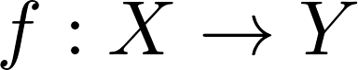
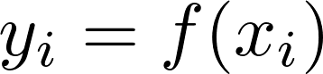
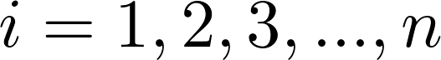
Supervised Learning
Dataset:
Input instances:
Known (desired) outputs:
Our goal:
Learn the mapping
such that for all

Slide 6
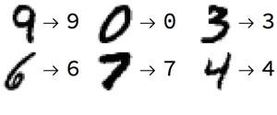
Continuous vs Discrete Problems
Regression: the desired labels are continuous Company earnings, revenue → company stock price
House size and age → price
Classification: the desired labels are discrete
Handwritten digits → digit label
User tweets → detect positive/negative sentiment
Regression or classification?
Model the salary of baseball players based on their game statistics
Find what object is on a photo
Predict election results

Slide 7
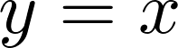
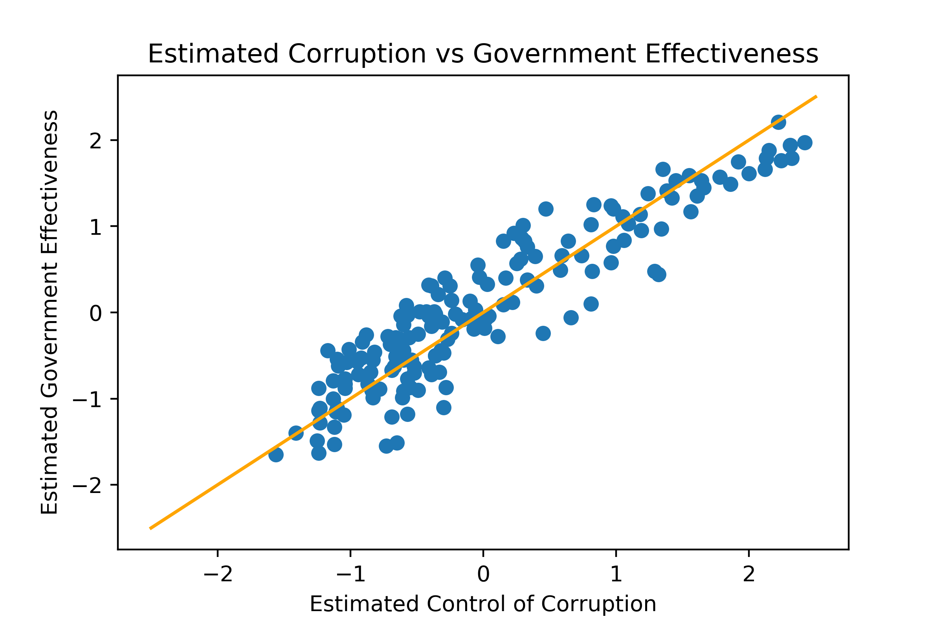
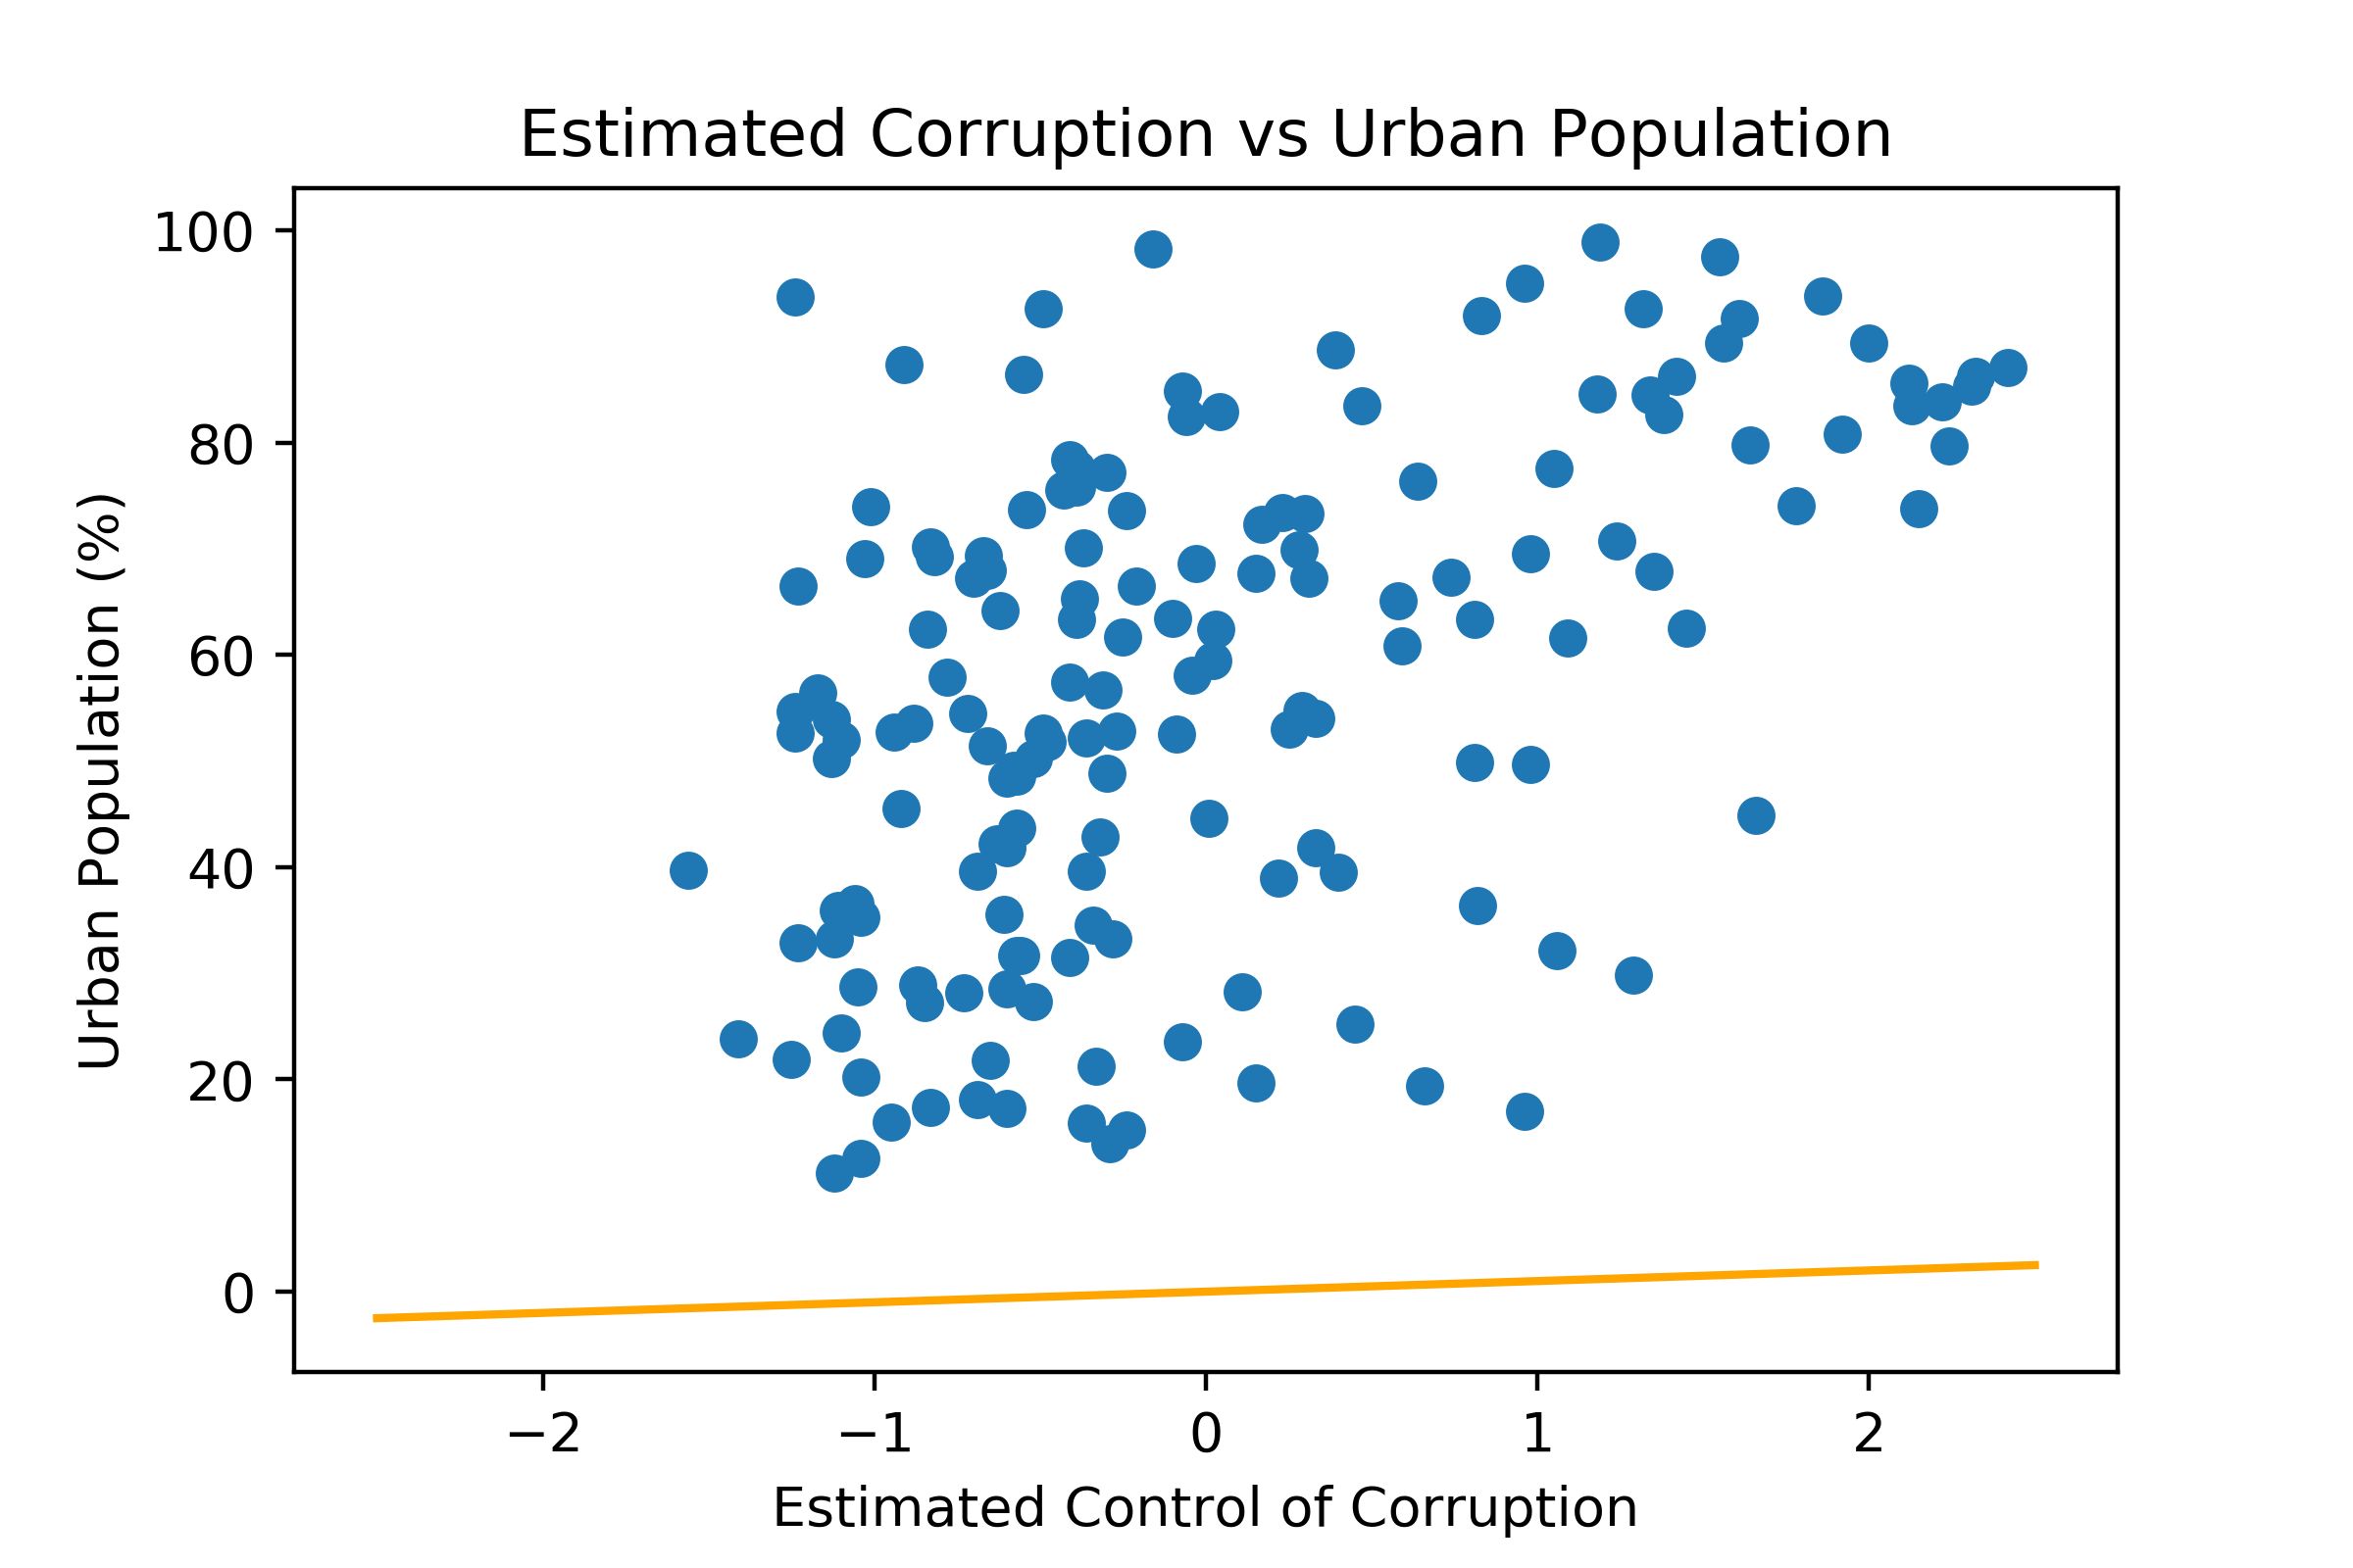
Simplest Possible Linear Model
What is the simplest possible model for ?

Slide 8
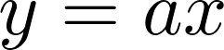
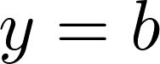
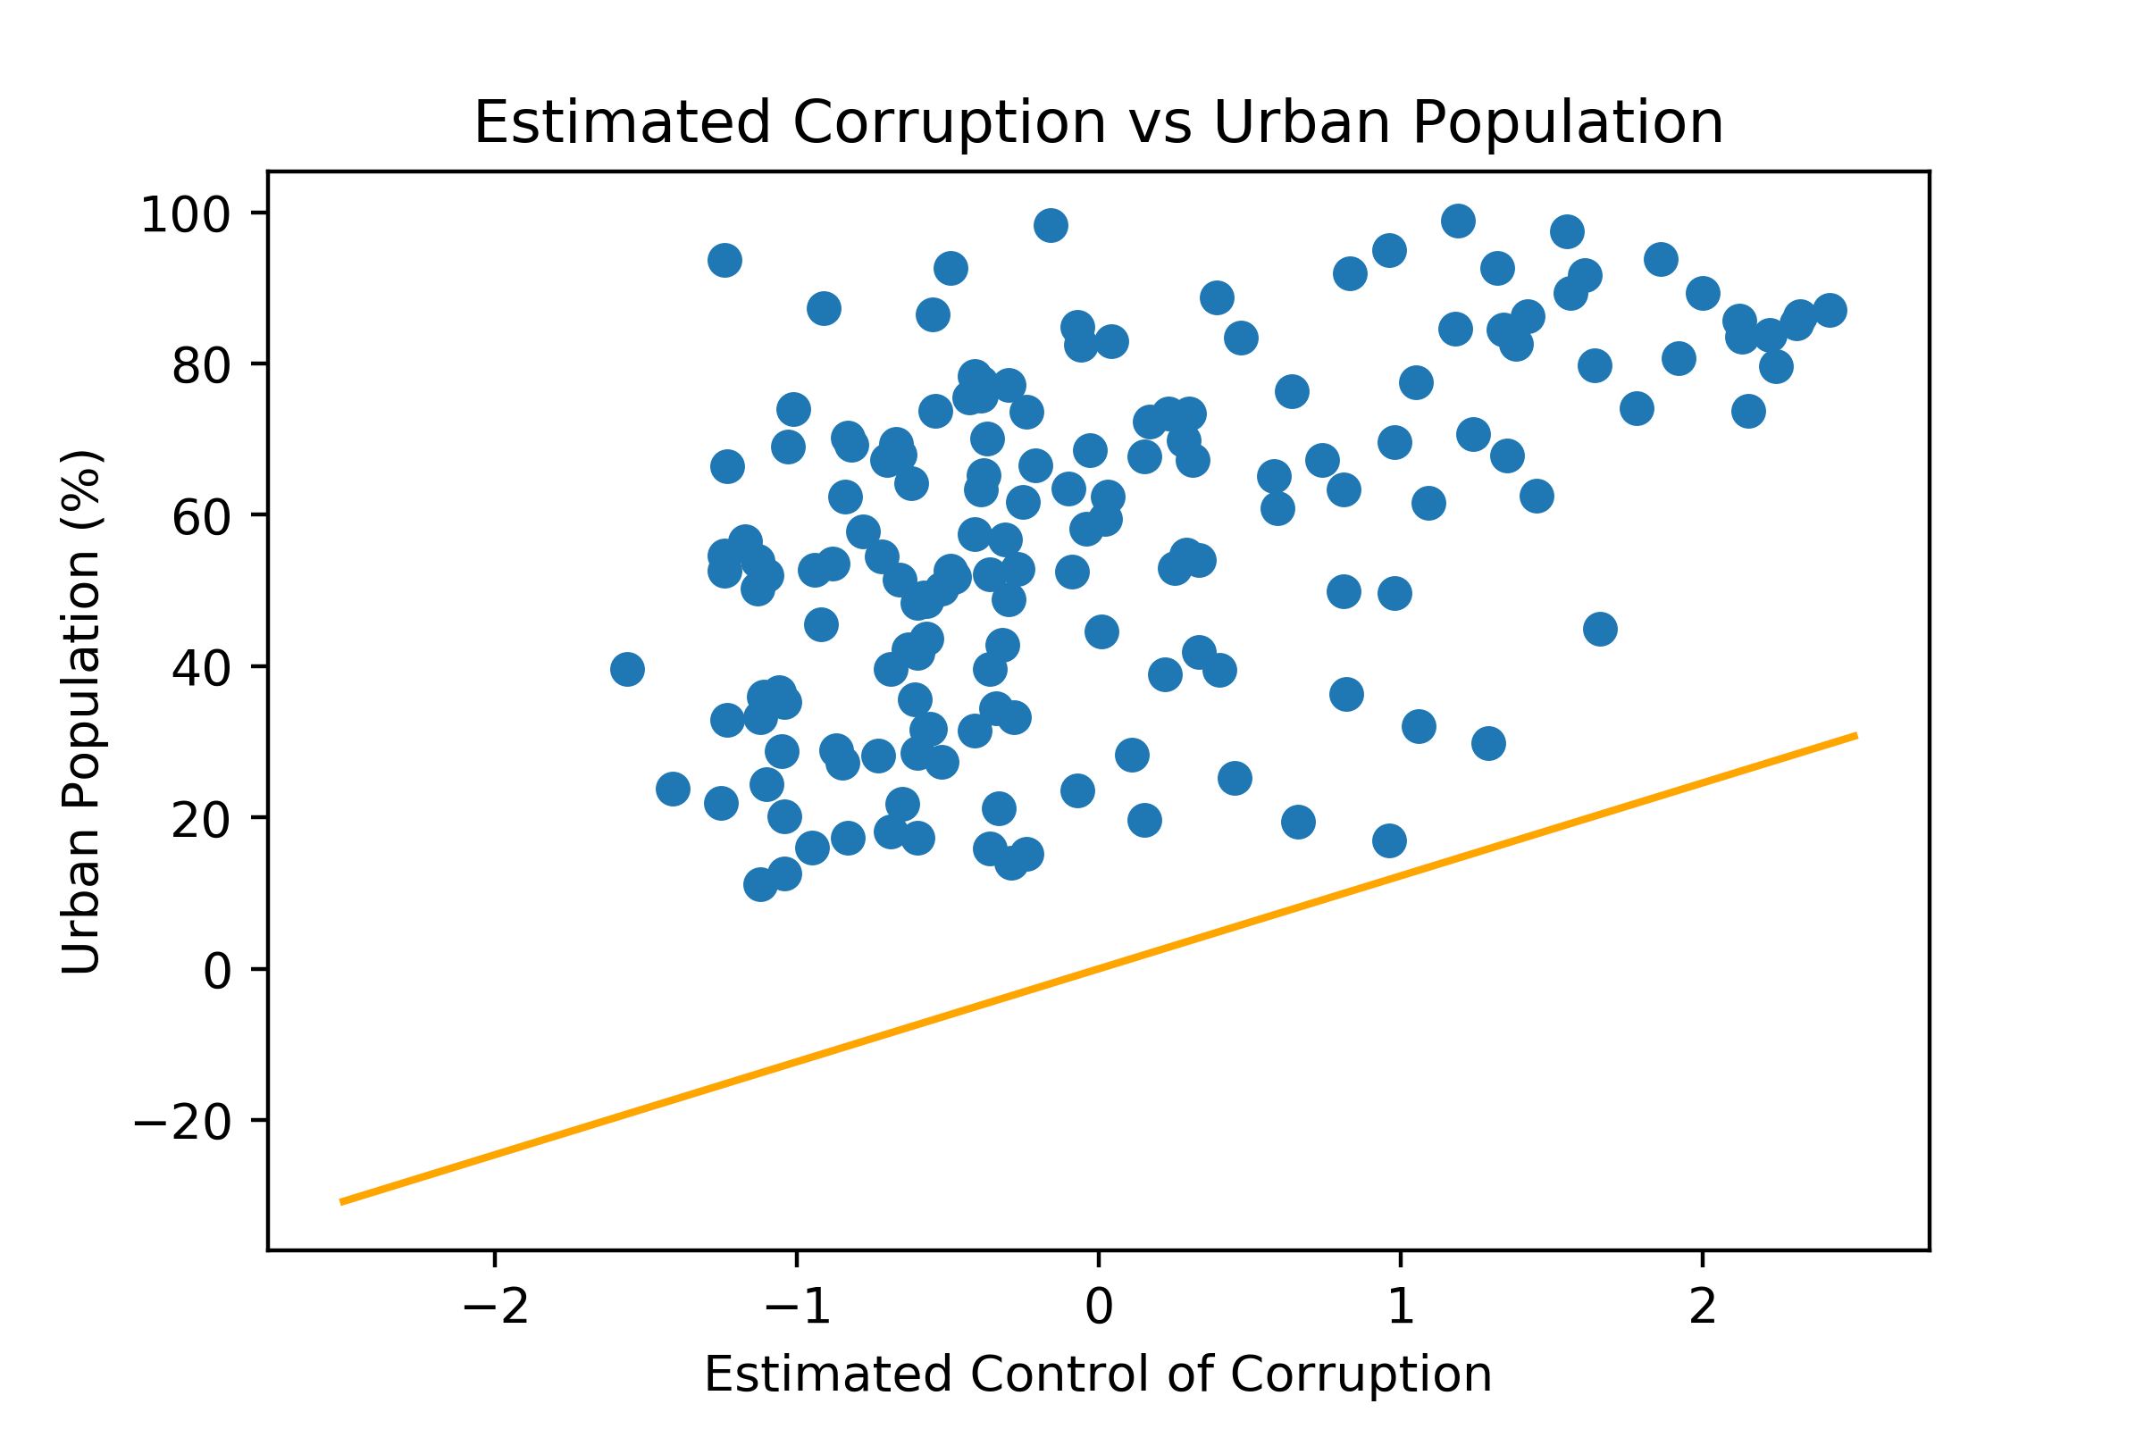
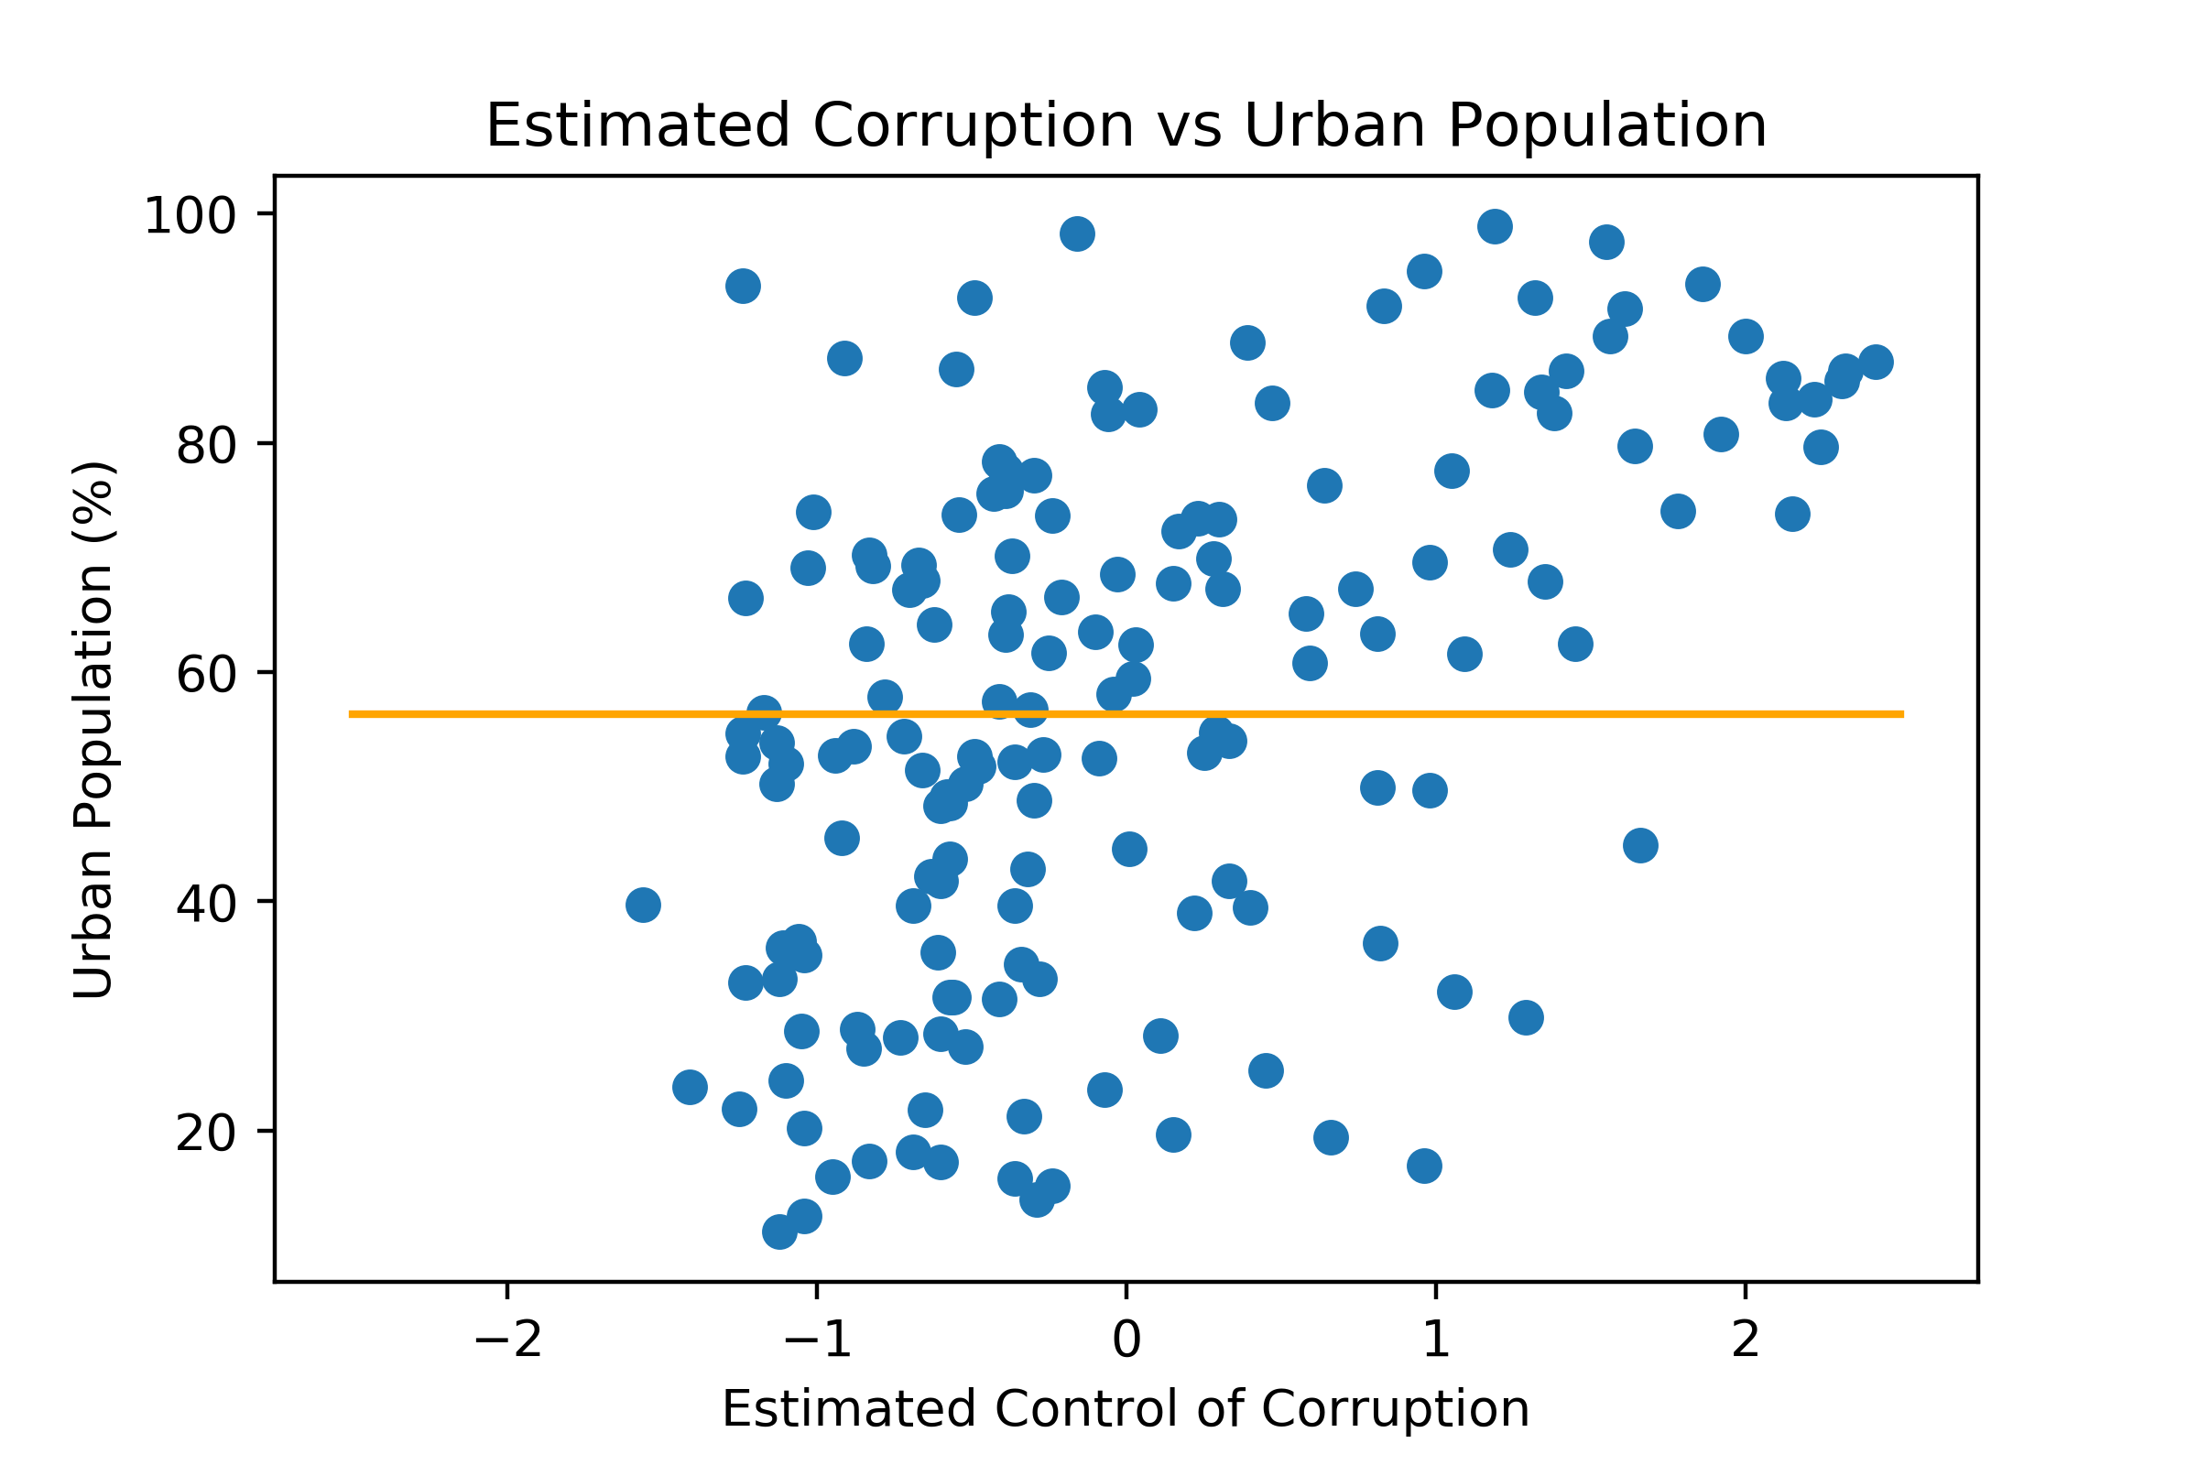
(Still Too Simple) Linear Models

Slide 9
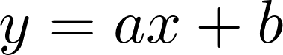
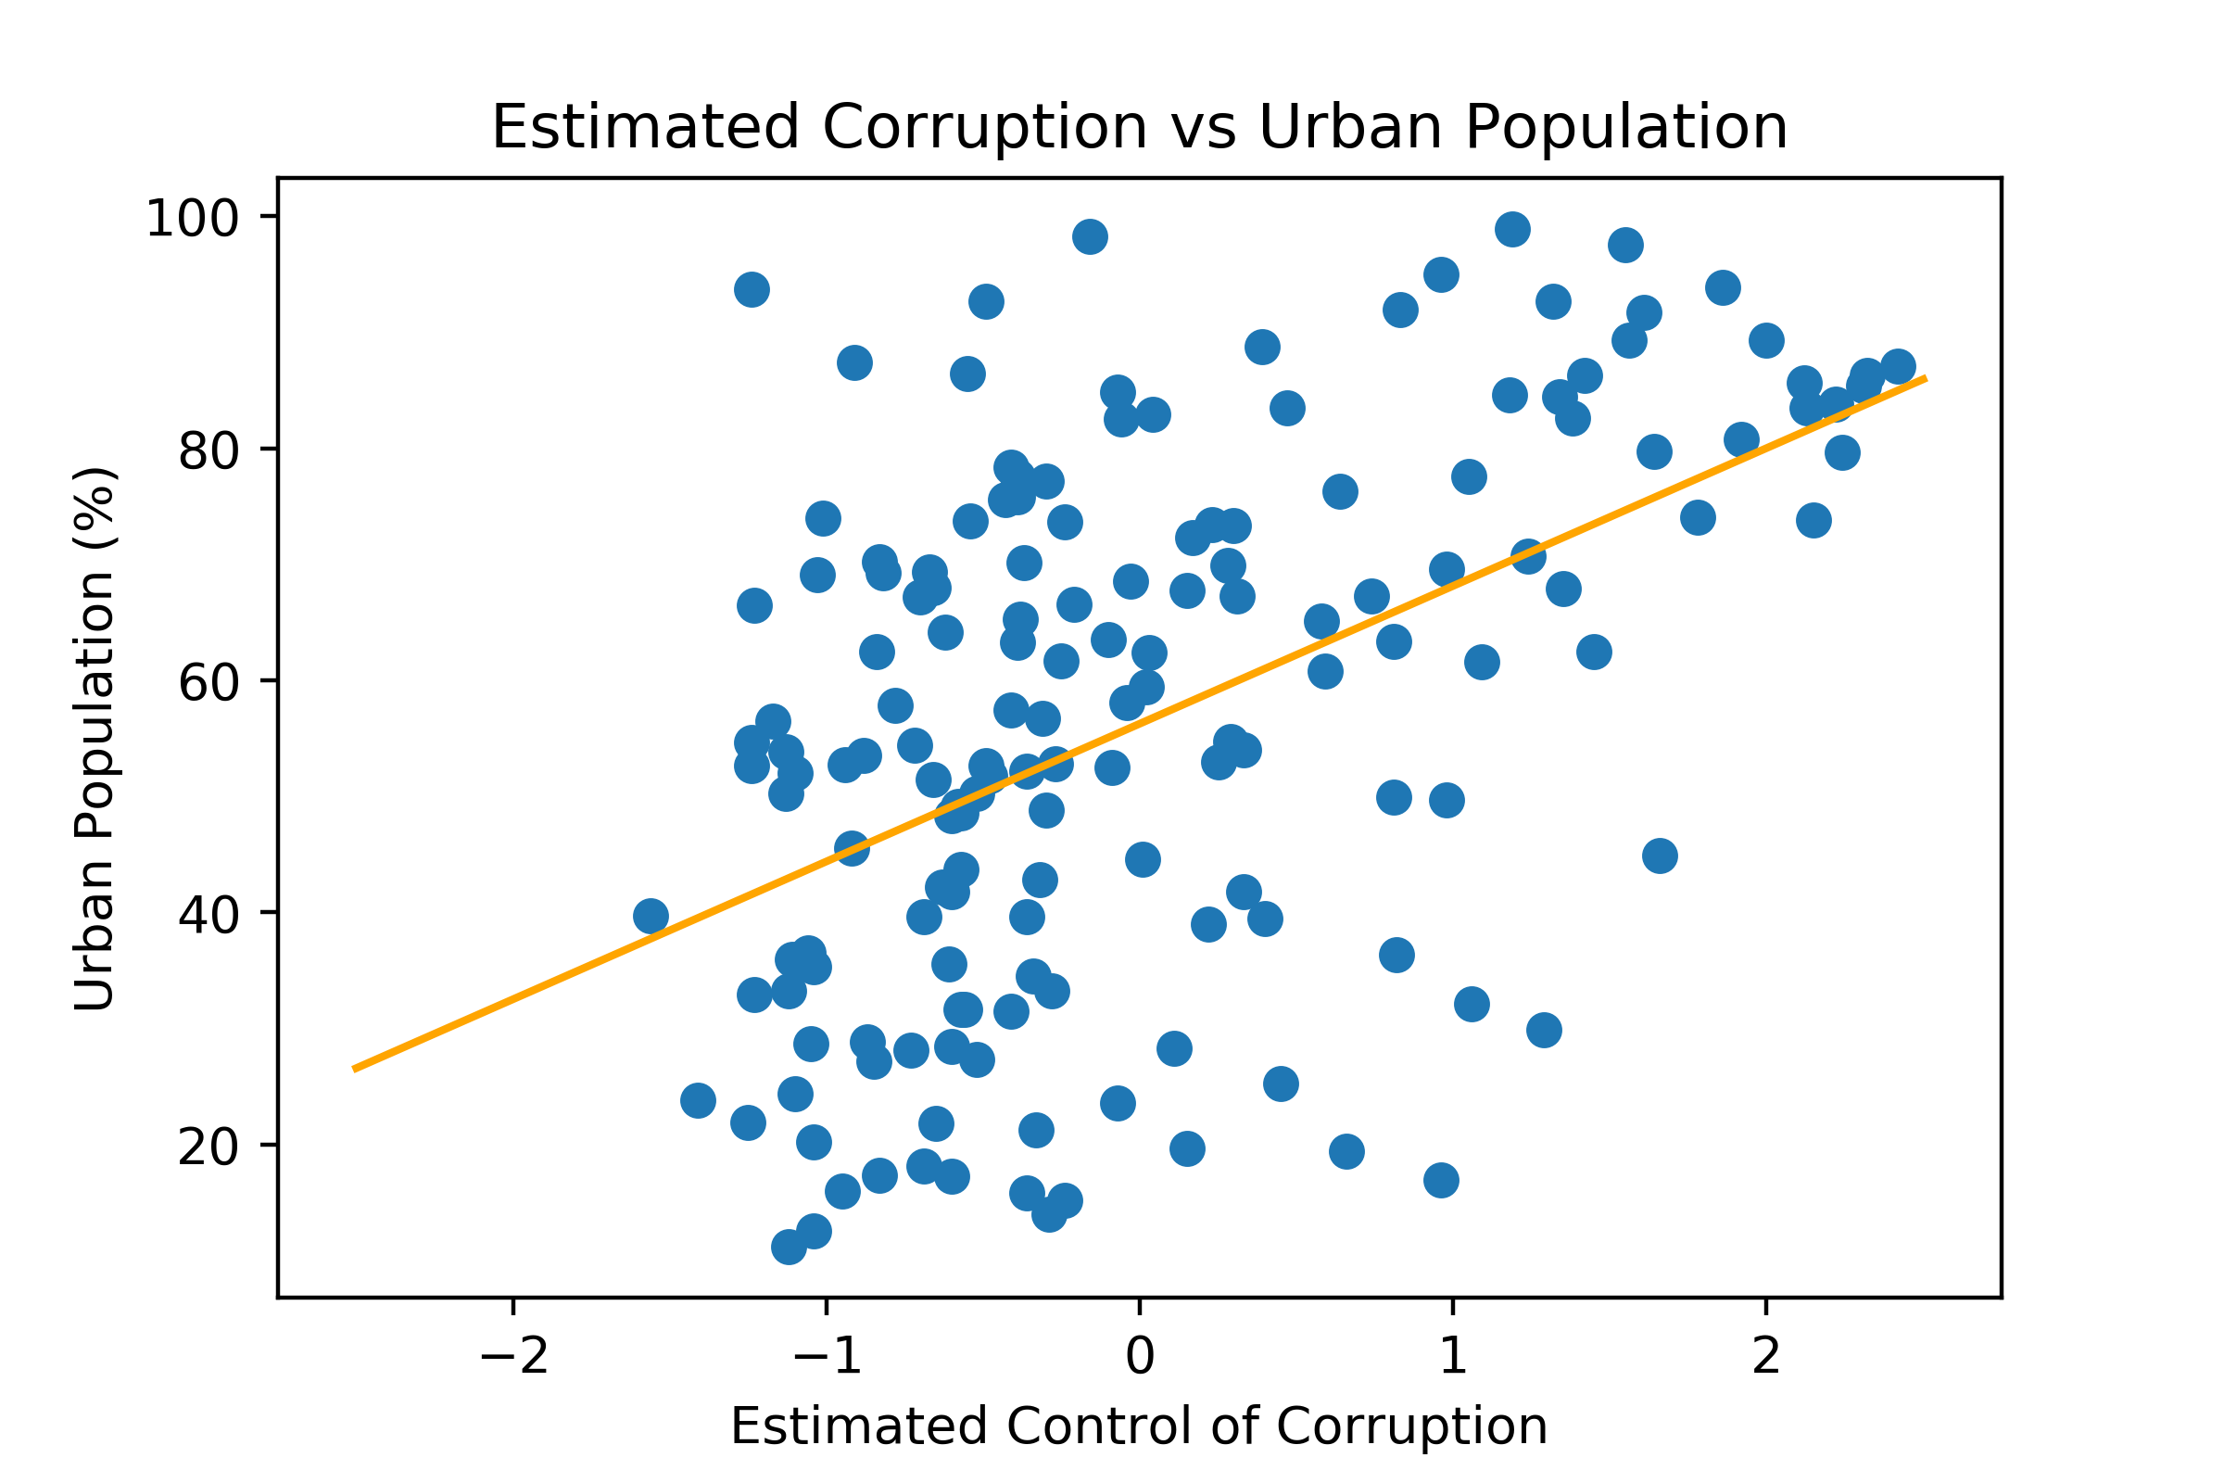
Linear Regression
Better linear model:
Controls the angle
Controls the intercept

Slide 10
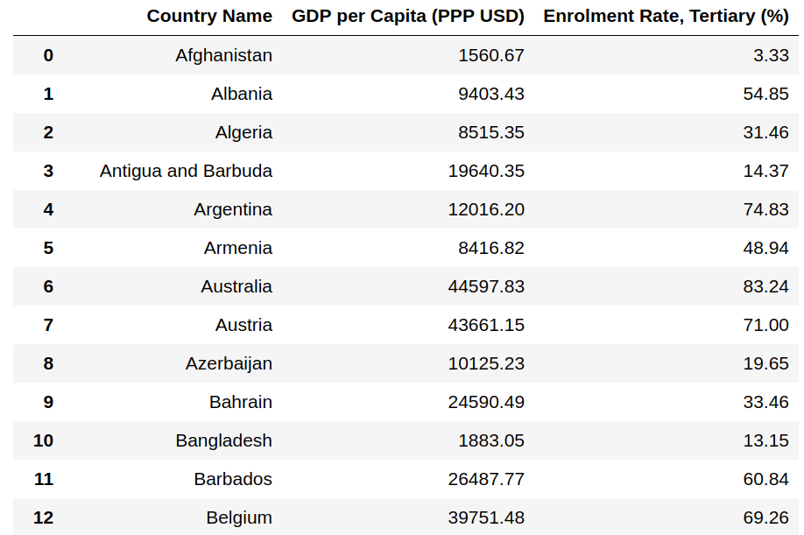
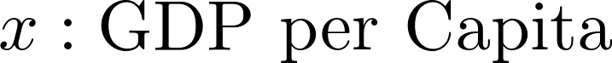
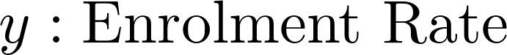
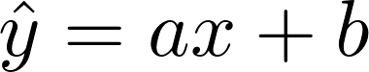
Linear Regression
How do we find the best values for a and b?

Slide 11
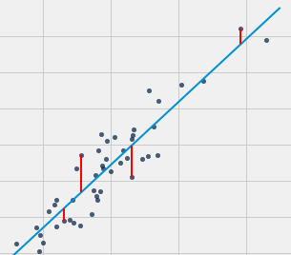
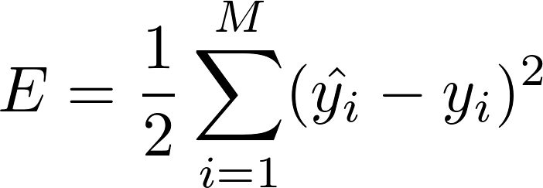
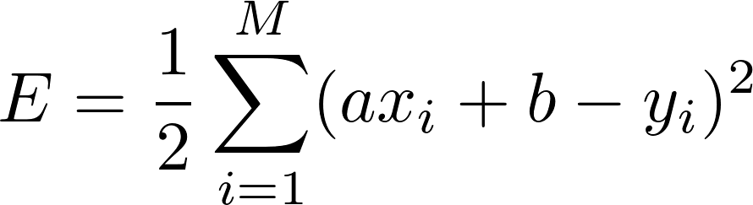
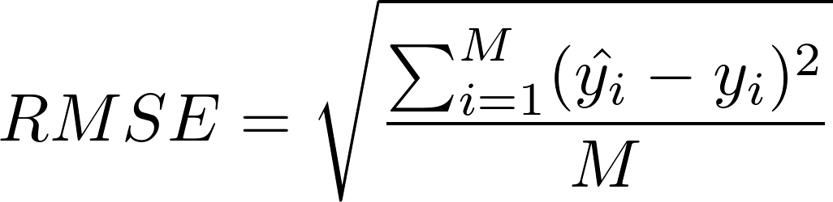
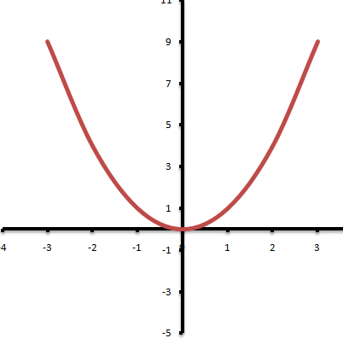
Loss Function
First, let’s define what “best” actually means for us.
Smaller value of E means our predictions are close to the real values
Individual large errors incur a large exponential penalty
Many small errors are acceptable and get a very small loss
Easily differentiable function

Slide 12
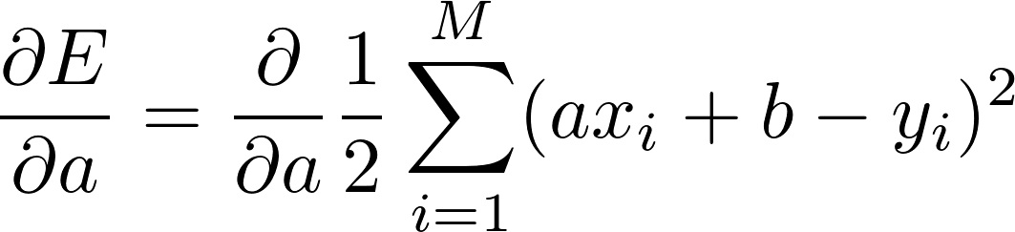
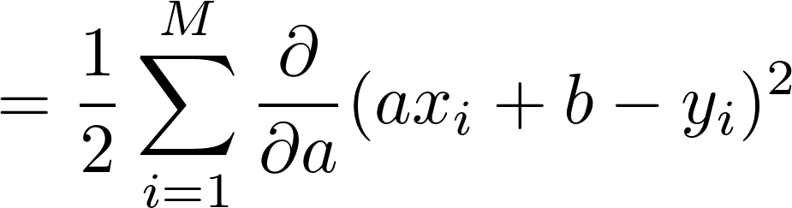
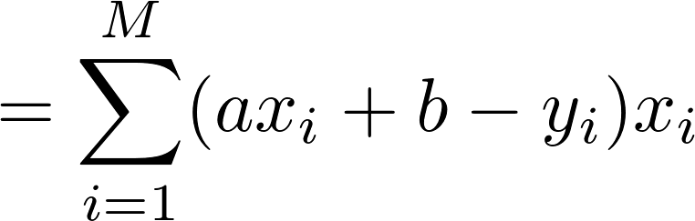
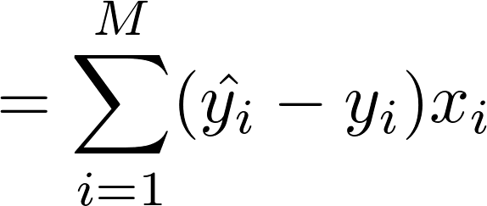
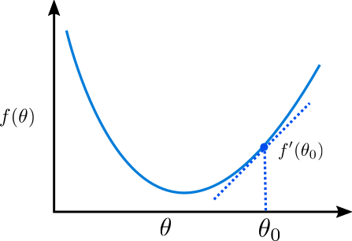
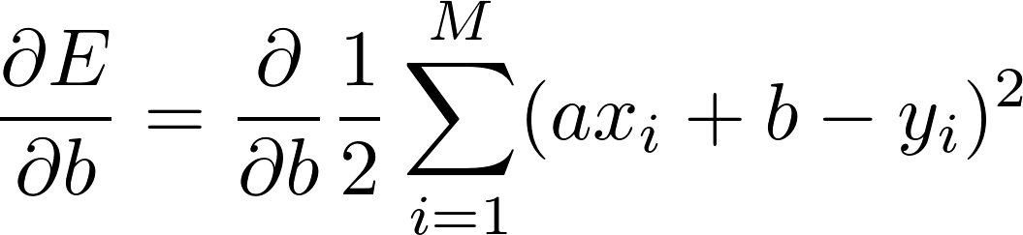
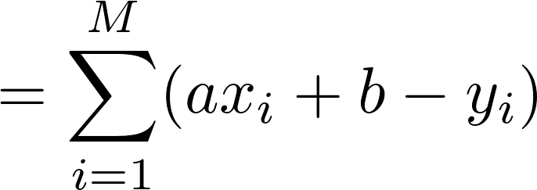
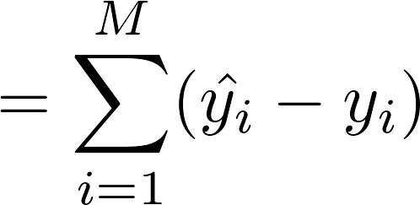
Gradient Descent
We can update a and b using the training data and the loss function.
The partial derivative of a function shows the direction of the slope.

Slide 13
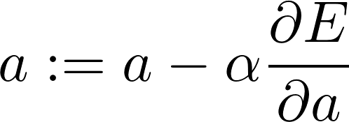
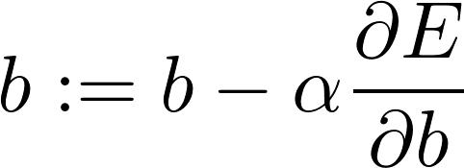

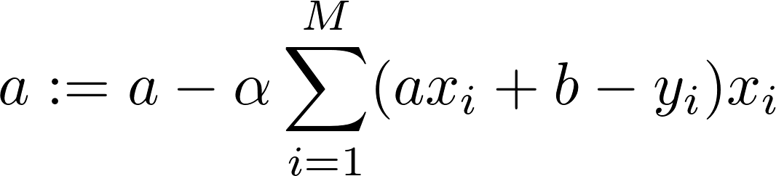
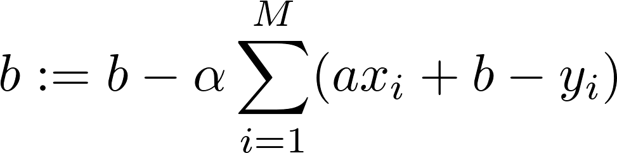
Gradient Descent
Gradient descent: Repeatedly update parameters a and b by taking small steps in the direction of the partial derivative.
: learning rate / step size
This same algorithm drives nearly all of the modern neural network models.

Slide 14
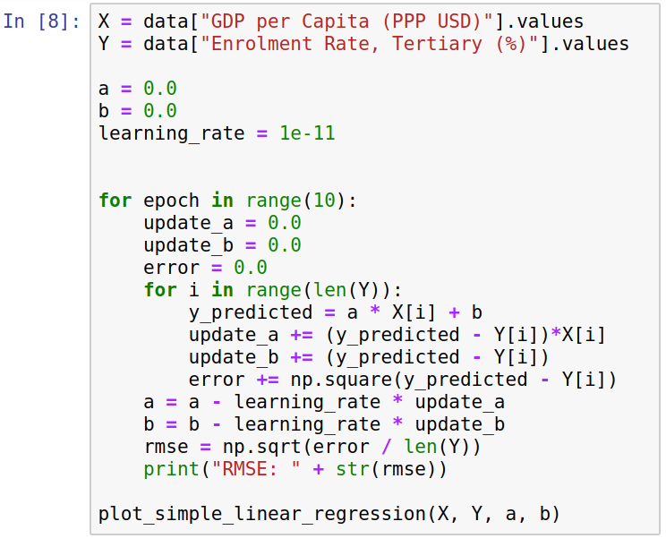
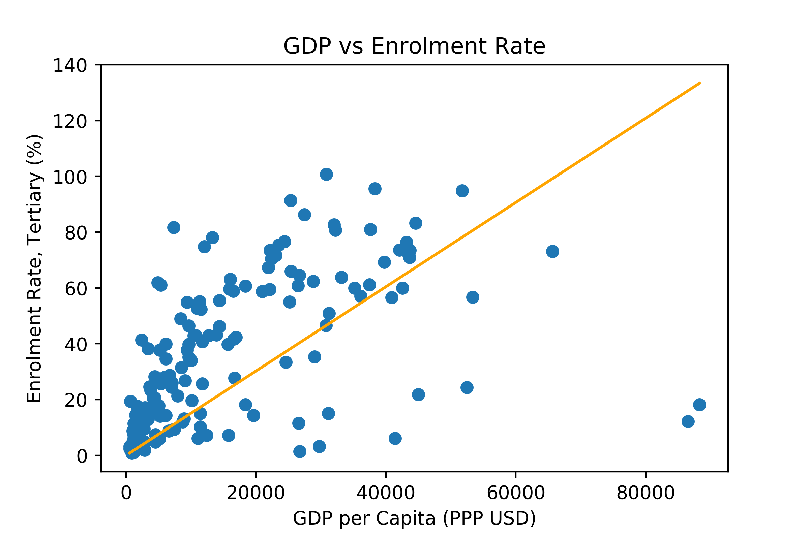
Gradient Descent
Implementing gradient descent by hand
RMSE: 43.60705215347086 RMSE: 27.764974739091667 RMSE: 27.121980238646962 RMSE: 27.101664900304836 RMSE: 27.101030544822766 RMSE: 27.101010737719825 RMSE: 27.101010112785858 RMSE: 27.101010086586154 RMSE: 27.101010079074783 RMSE: 27.10101007214674

Slide 15
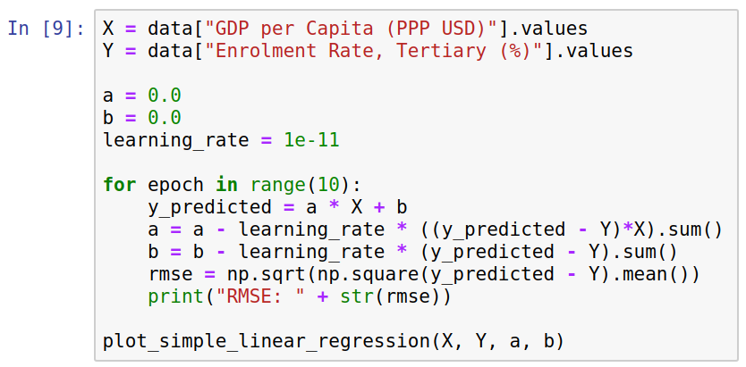
Gradient Descent
A more compact version, operating over all the datapoints at once.

Slide 16
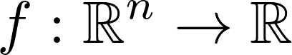
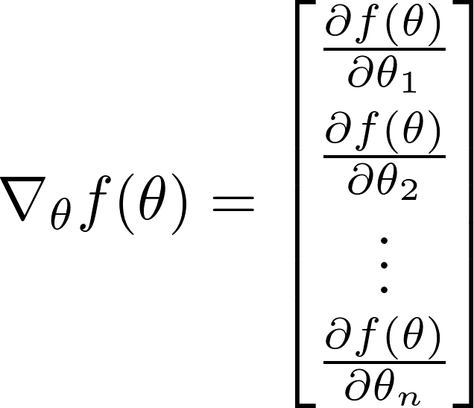
The Gradient
It can be more convenient to work with vector notation.
The gradient is a vector of all partial derivatives.
For a function , the gradient is

Slide 17
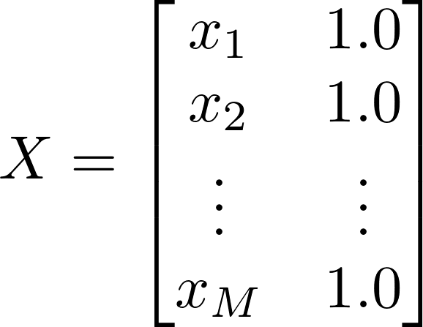
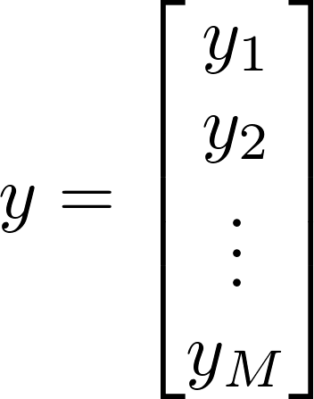
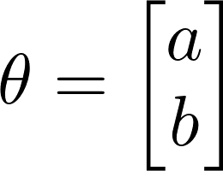
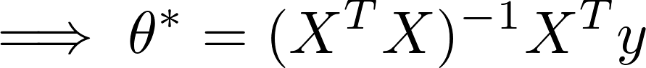
The Analytical Solution
Solving the single-variable linear regression with the analytical solution
Great for directly finding the optimal parameter values.
Not so great for large problems: matrix inversion has cubic complexity.

Slide 18
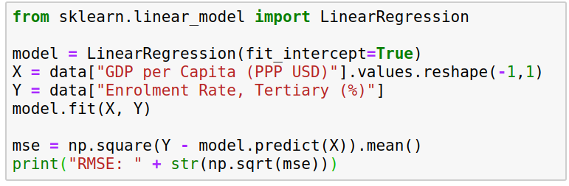
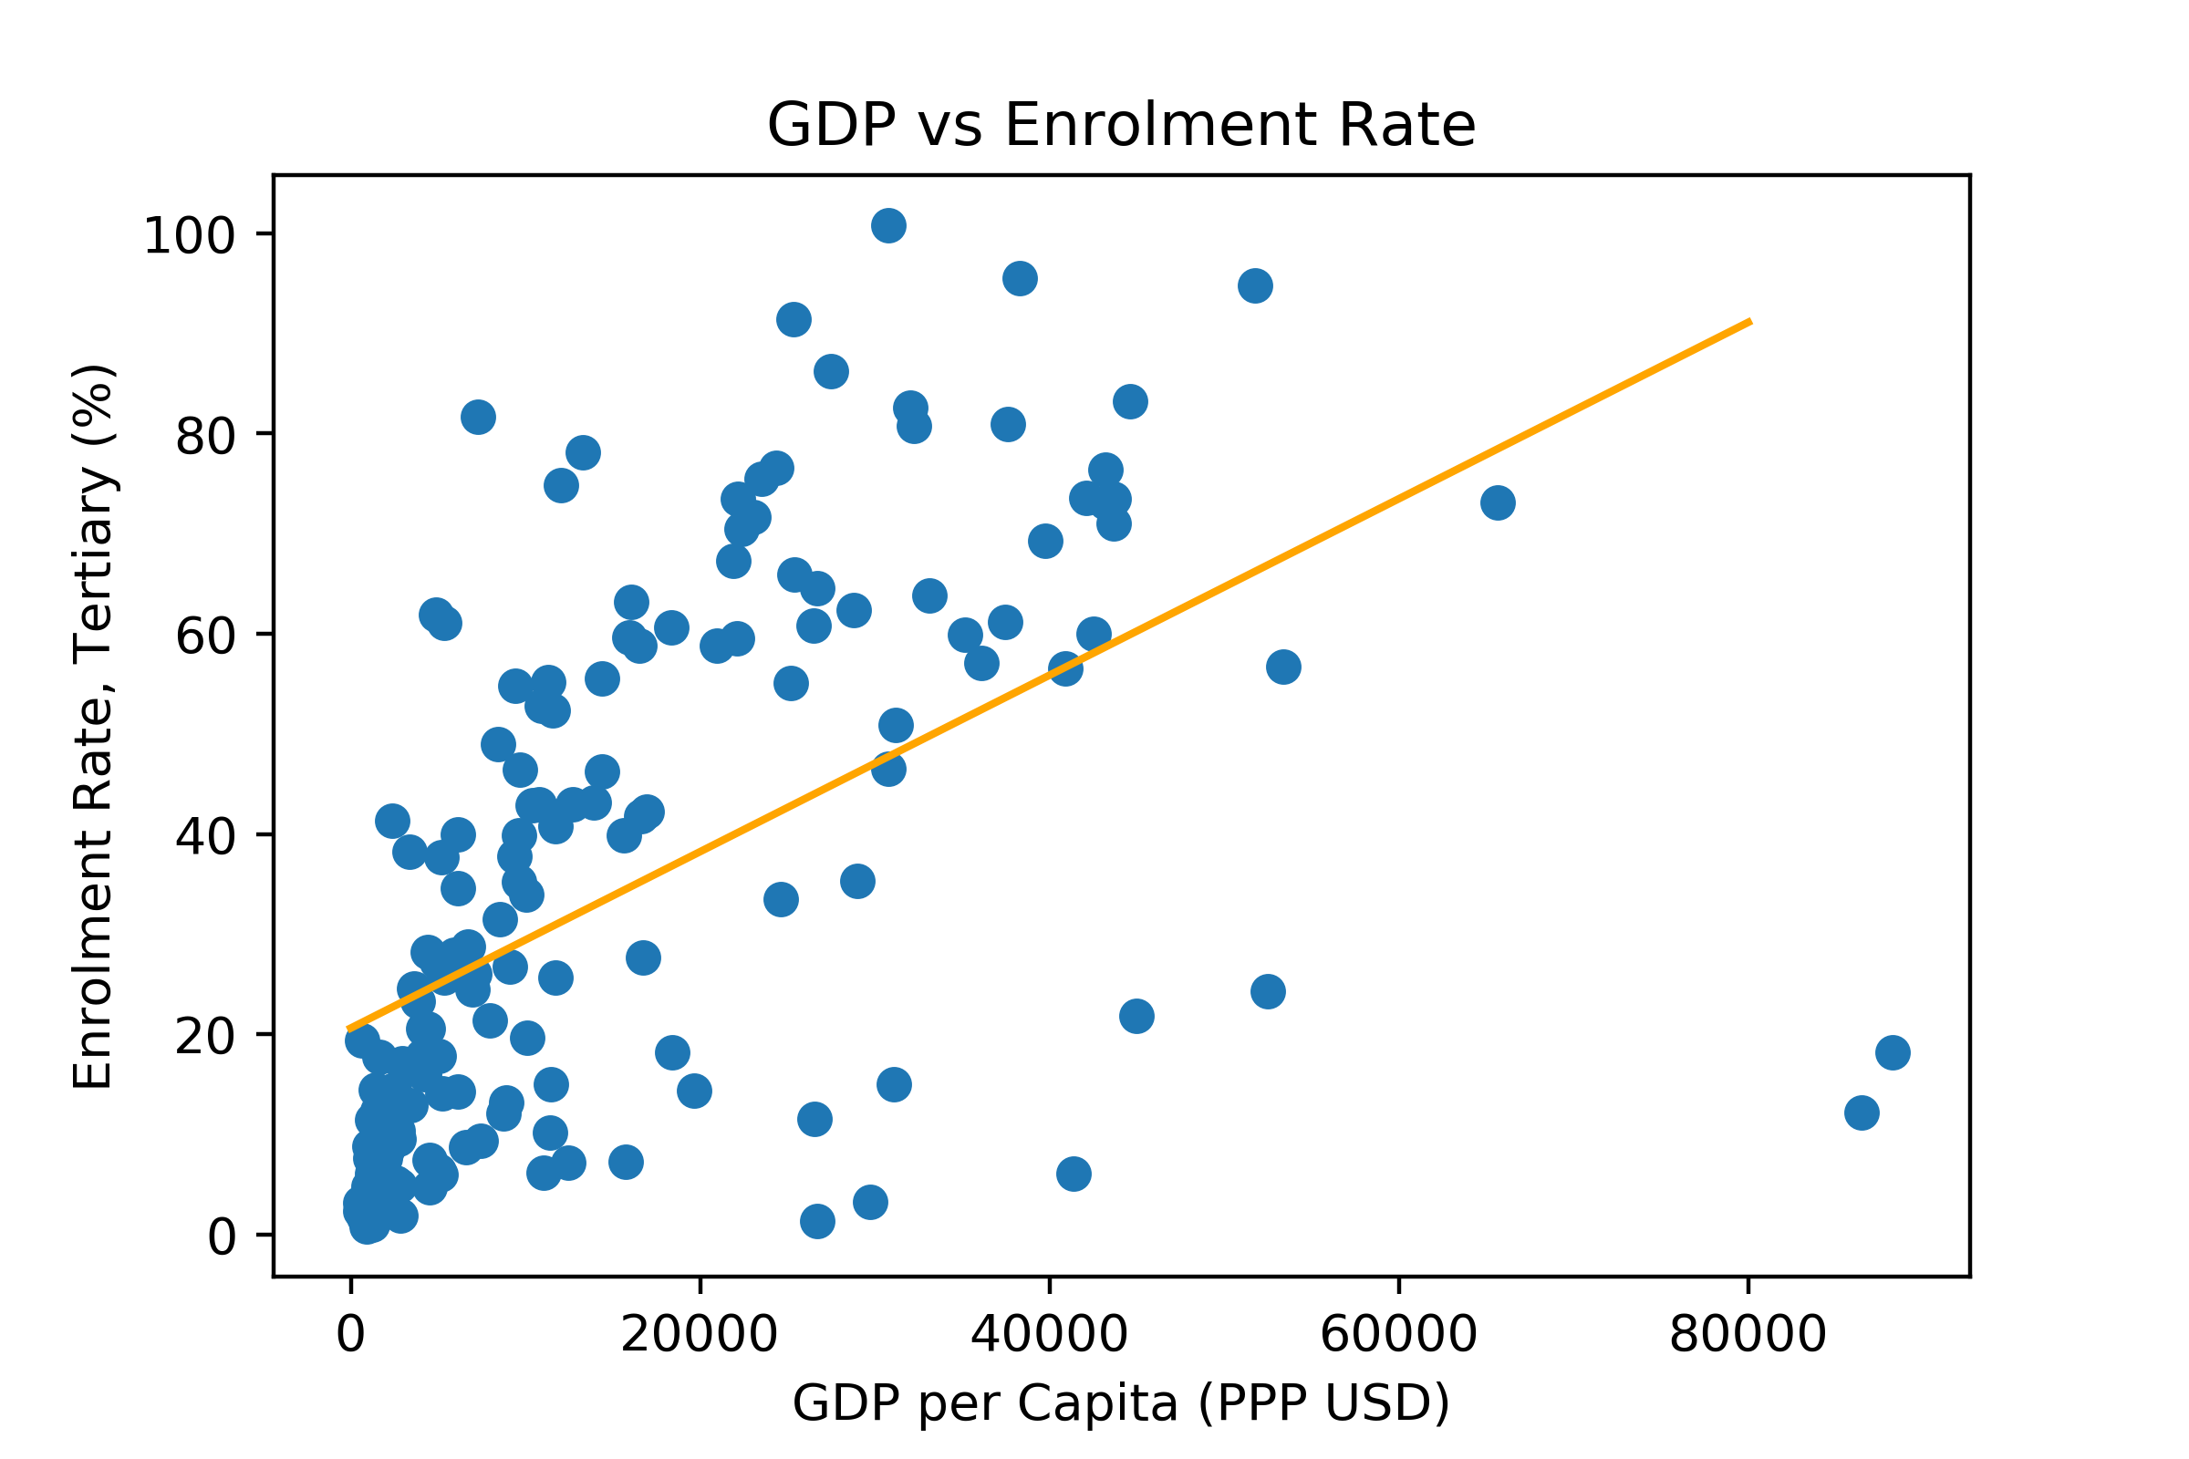
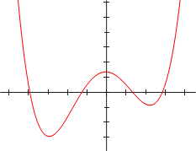
Analytical Solution with Scikit-Learn
RMSE: 22.630490998345973
Global minimum
Local minimum

Slide 19

Multiple Linear Regression
We normally use more than 1 input feature in our model
Output label
Input features

Slide 20


Multiple Linear Regression
RMSE: 14.40196

Slide 21


Exploring the Parameters
model.coef_ now contains optimized coefficients for each of the input features model.intercept_ contains the intercept

Slide 22


Exploring the Parameters
The coefficients are only comparable if we standardize the input features first.

Slide 23




Polynomial Features
Polynomial combinations of the features.
With degree 2, features would become
RMSE: 13.6692
Notes:
Polynomial regression is a special case of multiple linear regression.
As a statistical estimation problem it is linear, but because it uses polynomial features it is able to model non-linear data.

Slide 24


Polynomial Features
With 3rd degree polynomial features, the linear regression model now has 364 input features.
RMSE: 0.00018

Slide 25

Overfitting
There are twice as many features/parameters as there are datapoints in the whole dataset
This can easily lead to overfitting

Slide 26
Dataset Splits
Training Set
Development Set
Test Set
For training your models, fitting the parameters
For continuous evaluation and hyperparameter selection
For realistic evaluation once the training and tuning is done

Slide 27
Stratified Sampling
Making sure the proportion of classes is kept the same in the splits
Training Set
Development Set
Test Set
For training your models, fitting the parameters
For continuous evaluation and hyperparameter selection
For realistic evaluation once the training and tuning is done

Slide 28


Overfitting
Training set 3rd degree polynomial features
Development set 3rd degree polynomial features
RMSE: 1.1422e-07
RMSE: 133.4137

Slide 29


Overfitting
Development set 2nd degree polynomial features
Development set 1st degree polynomial features
RMSE: 68.4123
RMSE: 16.1414

Slide 30


Overfitting
Training set 1 input feature (GDP) 3rd degree polynomial features
Development set 1 input feature (GDP) 3rd degree polynomial features
RMSE: 19.8130
RMSE: 15.9834

Slide 31

GDP vs Enrolment Rate

Slide 32
Practical 1

Slide 33


Data
California House Prices Dataset containing information on a number of independent variables about the block groups in California from 1990 Census
Dependent variable: house price

Slide 34
Your task: Learning objectives
Load the dataset
Understand the data, the attributes and their correlations
Split the data into training and test set
Apply normalisation, scaling and other transformations to the attributes if needed
Build a machine learning model
Evaluate the model and investigate the errors
Tune your model to improve performance

Slide 35
Practical 1 Logistics
Data and code for Practical 1 can be found on: Github (https://github.com/ekochmar/cl-datasci-pnp/tree/master/DSPNP_practical1), Azure Notebooks (https://notebooks.azure.com/ek358/projects/data-science-pnp-1920/tree/DSPNP_practical1) or Moodle
Practical session is on Tuesday 12 November, 3-4pm, at the Intel Lab
At the practical, be prepared to discuss the task and answer the questions about the code to get a ‘pass’
After the practical, upload your solutions (Jupyter notebook or Python code) to Moodle

